Slide 1


Project Management Best Practice

Slide 2

1
Background
Nama Proyek | Pengguna Jasa | Penugasan | Tahun
Enterprise Governance and Information Security | Pertamina Hulu Energi | Central Project Manager | 2024
Jasa Konsultansi Evaluasi Performansi Layanan Kantor Cabang PT Angkasa Pura II | PT Angkasa Pura II | Team Leader | 2023
Asesmen Pelindungan dan Keamanan Data - BUMN Holding Farmasi Bio Farma Group | PT Biofarma | Project Manager | 2023
Pengadaan Sarana Penunjang Pemungutan PNBP Pasca Produksi (Timbangan Elektronik) | DirJen Perikanan Tangkap KKP | Project Manager | 2022
Implementasi dan Sertifikasi Tata Kelola, Maturitas TI, dan Business Continuity Plan Holding | PT Biofarma (Persero) | Business Strategy Expert | 2021 - 2022
Madubaru, Sugar Mills and Plantation – Jogjakarta | Madubaru | Commissioner | 2013-2016
Rajawali Nusantara Indonesia (State Owned Enterprise) | Rajawali Nusantara Indonesia | Chief Operating Officer (COO) | 2012 - 2015
Rajawali Nusindo, Trading and Distribution – Jakarta | Rajawali Nusindo | President Commissioner | 2012 - 2013
Mitra Rajawali Banjaran, Healthcare factory - Bandung | Mitra Rajawali Banjaran | Chief Executive Officer (CEO) | 2010 - 2012
Rajawali Nusantara Indonesia, Holding (SOE)-Jakarta | SOE | Assistant Deputy Director for Enterprise Risk Management | 2004 – 2010
Matsushita Gobel Education Foundation (YPMG)-Jakarta | YPMG | Executive Director | 2003 – 2004
Jakarta Stock Exchange (JSX) - Jakarta | JSX | Corporate Communications - Head of Division | 1994 – 2003
Indonesian Aircraft Industry (IPTN) – Bandung | IPTN | System Programmer | 1988 - 1994
Boeing - USA | International 4H Employe Exchange | Boeing Seattle - USA | 1986 -1988
PT ATCO Utama Engineering – Bandung | PT ATCO Utama | Programmer | 1985 – 1986
PT Radio OZ - Bandung | PT Radio OZ | Announcer | 1984 - 1985

Slide 3

What is Project ?
The word project comes from the Latin word projectum from the Latin verb proicere, "before an action", which in turn comes from pro-, which denotes precedence, something that comes before something else in time (paralleling the Greek πρό) and iacere, "to do". The word "project" thus originally meant "before an action".
A project is a type of assignment, typically involving research or design, that is carefully planned to achieve a specific objective
2

Slide 4

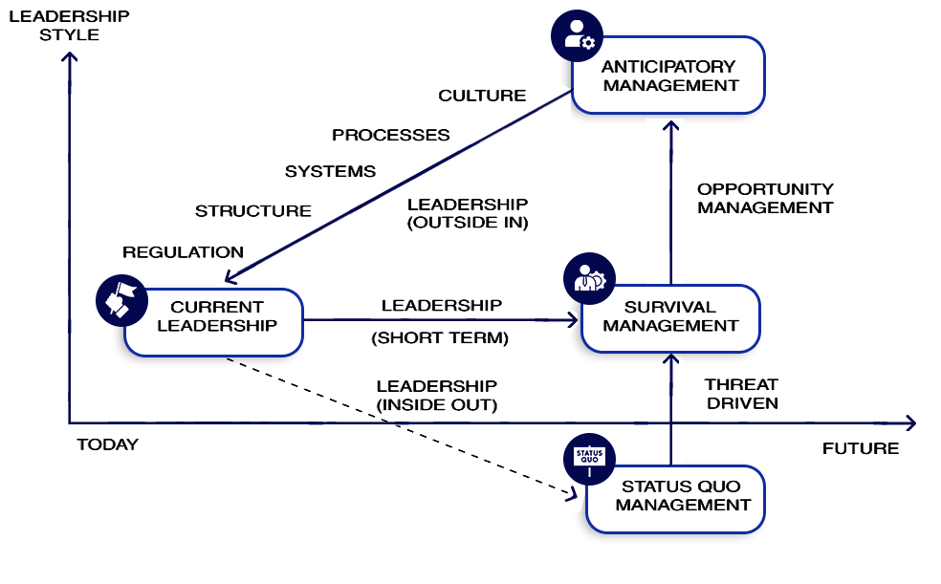
Leadership Style
3

Slide 5





Surrounding Environment
Culture
Tradition
Habit
Rules, etc
Process
Company Type
Business Type
System
(More on technology and rules)
Structure
Organization Structure
Career Path
7

Slide 6
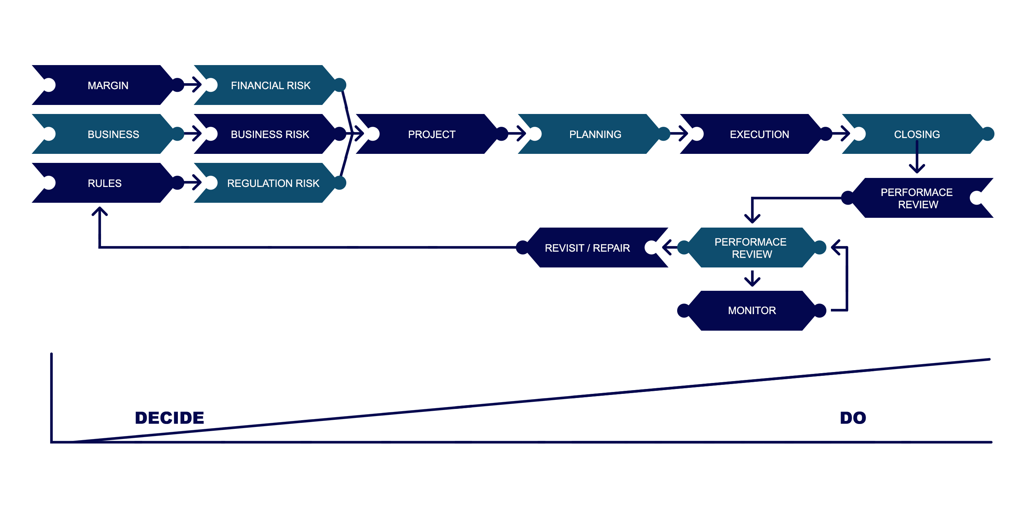
The Cycle Framework
5

Slide 7


Self destructive habit of a good company
Obsesi Kapasitas
Menyangkal
VOLUME
OBSESSION
(Rising Costs
and Falling Margins)
DENIAL
(Cocoon of Myth, Ritual
and Orthodoxy)
ARROGANCE
(Pride Before the Fall)
“Hanya Kita yang bisa”
Berpikiran Sempit / pendek
Merasa Puas
TERRITORIAL
IMPULSE
(Culture Conflicts
and Turf Wars)
COMPLACENCY
(Success Breeds
Failure)
Berpikiran Sempit / pendek
COMPETENCY DEPENDENCE
(Curse of Incumbency)
COMPETITIVE
MYOPIA
(Nearsighted View
Of Competition)
Ketergantungan
6

Slide 8
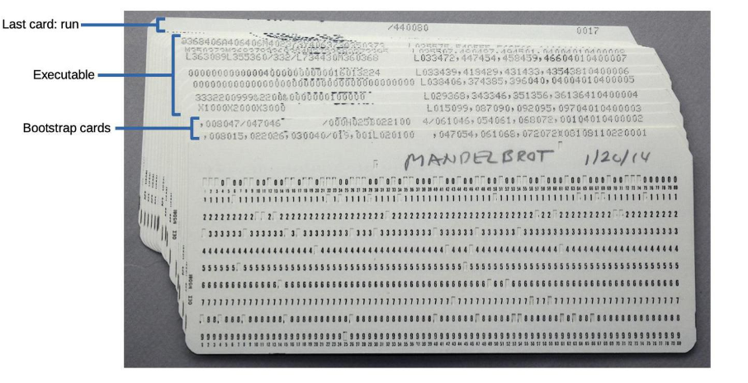
Flashback
8

Slide 9

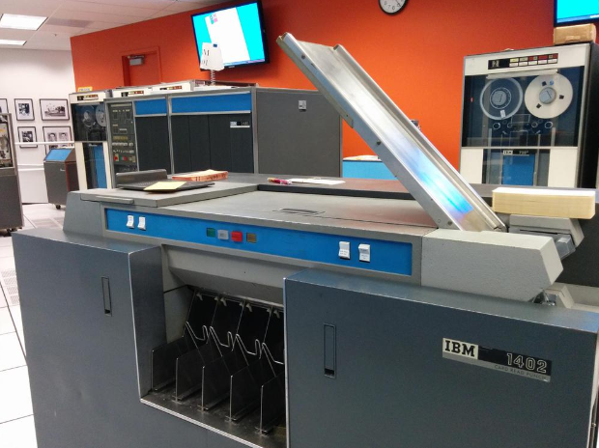
Flashback
8

Slide 10

Wrap Up
MUDAH
“Pandai cerdik” or “Cerdik Pandai”
MURAH
AMAN
8

Slide 11
TERIMA KASIH

